Slide 1
Review of Machine Learning Concepts

Slide 2
Outline
Recap of Supervised Learning
Key Concepts

Slide 3
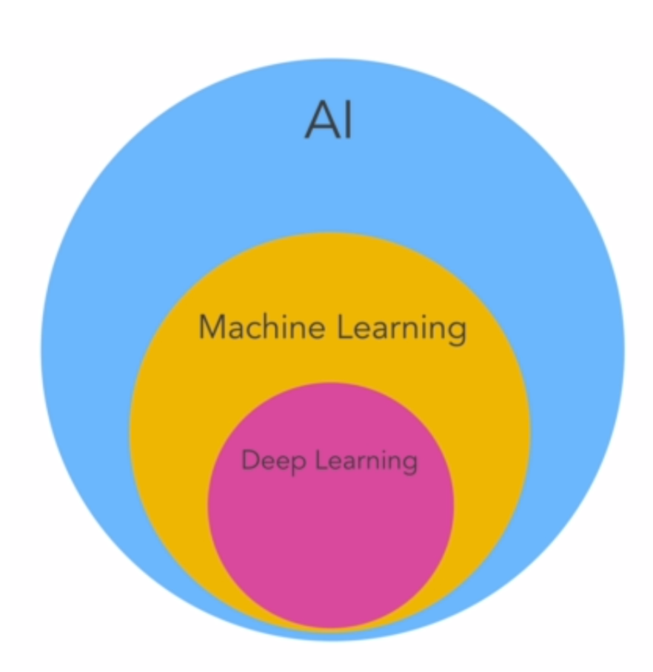
Machine Learning
Machine Learning is the process of training a piece of software, called a model, to make useful predictions or generate content from data.

Slide 4
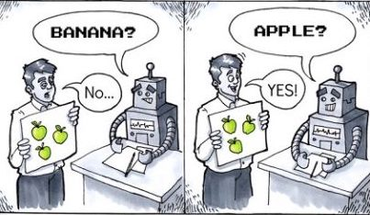
Supervised Learning
Supervised models can make predictions after seeing lots of data with the correct answers and then discovering the connections between the elements in the data that produce the correct answers.
These ML systems are "supervised" in the sense that a human gives the ML system data with the known correct results

Slide 5
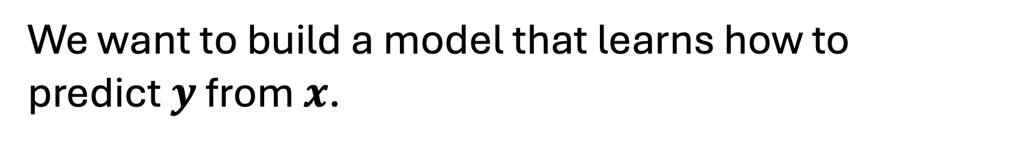
Supervised Learning
Given a set of data points $\left\{x_{1},…,x_{n}\right\}$
And the associated set of outcomes $\{y_{1},…,y_{n}\}$
We want to build a model that learns how to predict $y$ from $x$.

Slide 6
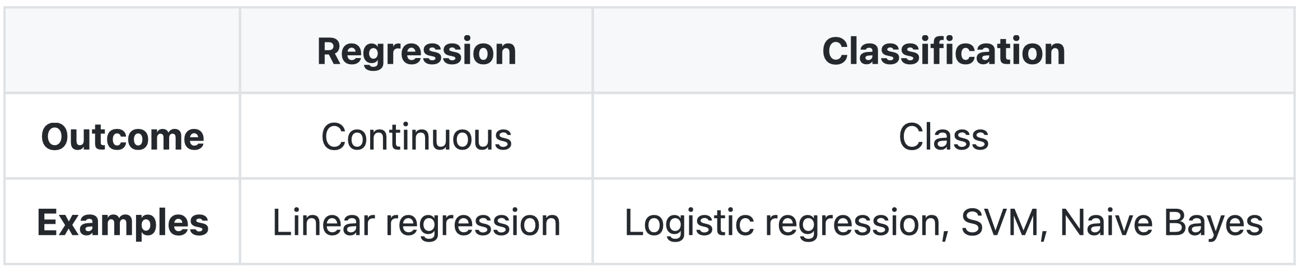
Types of Predictions

Slide 7
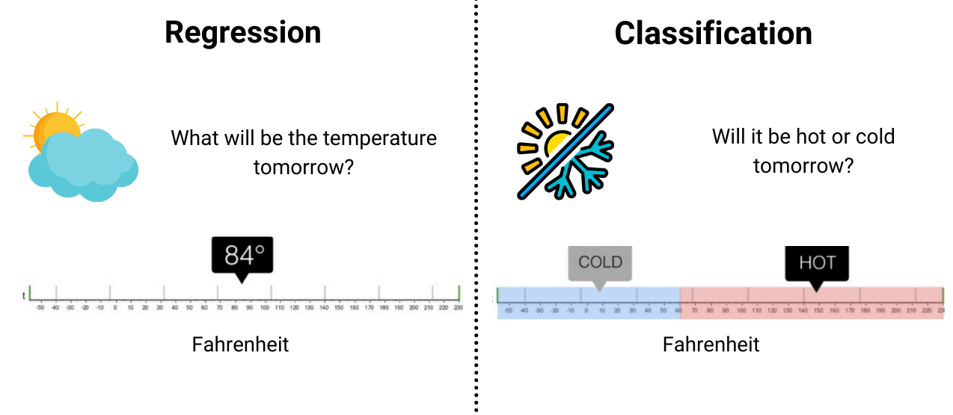
Regression model
A regression model predicts a continuous numeric value.
For example, a weather model that predicts the amount of rain, in inches or millimeters, is a regression model.

Slide 8
Classification model
Classification models predict the likelihood that something belongs to a category.
Unlike regression models, whose output is a number, classification models output a value that states whether or not something belongs to a particular category.

Slide 9

Outline
Recap of Supervised Learning
Key Concepts

Slide 10
Data
Data comes in the form of words and numbers stored in tables, or as the values of pixels and waveforms captured in images and audio files.
We store related data in datasets.
For example, we might have a dataset of the following:
Images of cats
Housing prices
Weather information

Slide 11
Dataset
Datasets are made up of individual examples that contain features and a label.
Features are the values that a supervised model uses to predict the label.
The label is the "answer," or the value we want the model to predict.

Slide 12
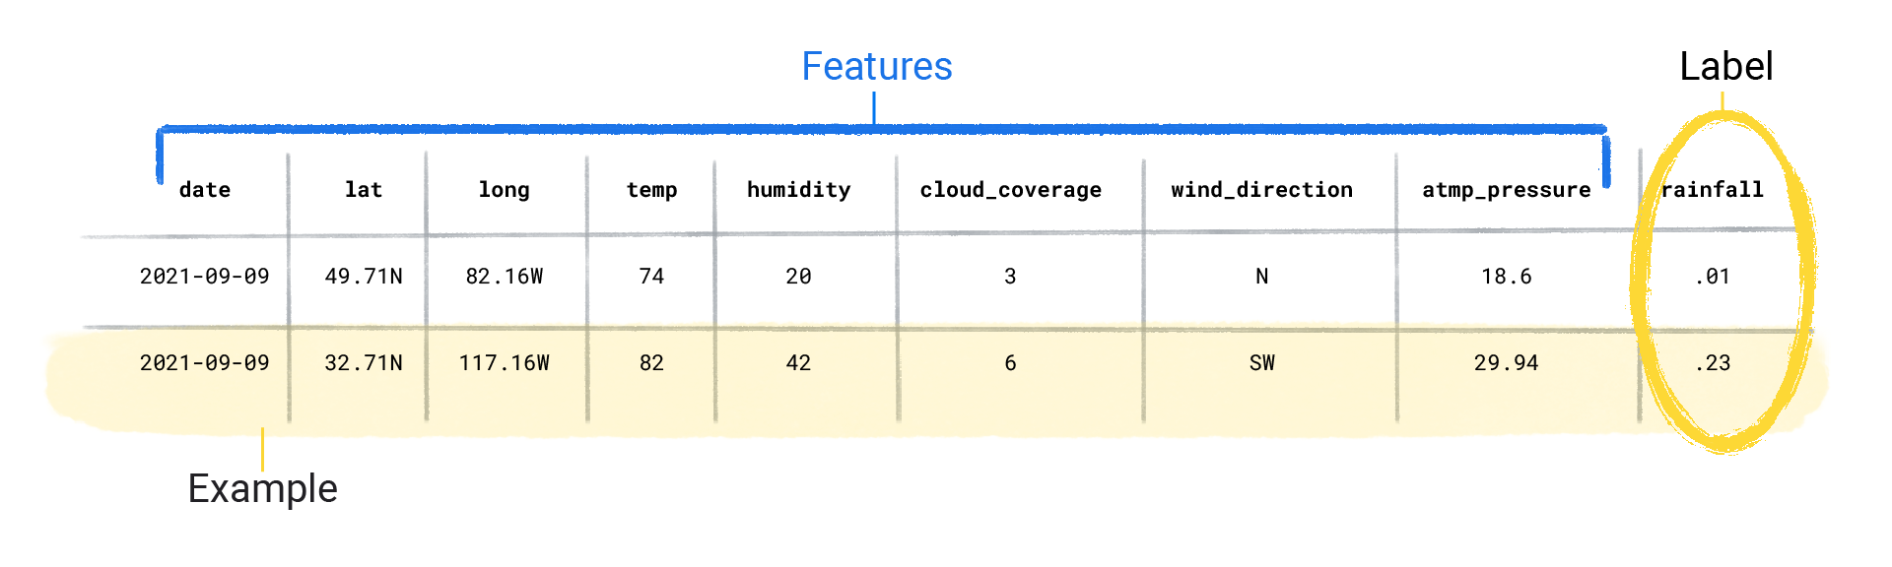
Dataset

Slide 13
Model
In supervised learning, a model is the complex collection of numbers that define the mathematical relationship from specific input feature patterns to specific output label values.
The model discovers these patterns through training.

Slide 14
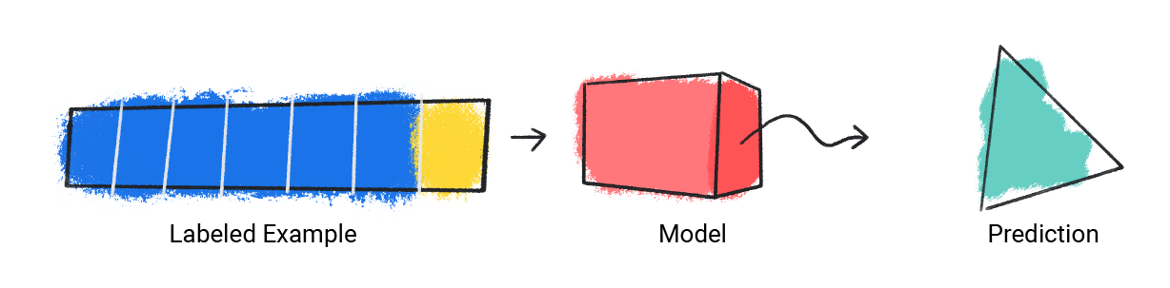
Model Training
Before a supervised model can make predictions, it must be trained.
To train a model, we give the model a dataset with labeled examples.
The model's goal is to find out the best solution for predicting the labels from the features.

Slide 15
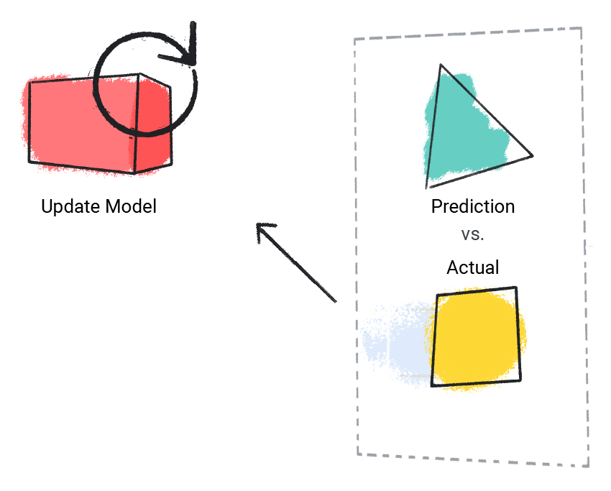
Model Training
The model finds the best solution by comparing its predicted value to the label's actual value.
Based on the difference between the predicted and actual values, defined as the loss, the model gradually updates its solution.
In other words, the model learns the mathematical relationship between the features and the label so that it can make the best predictions on unseen data.

Slide 16
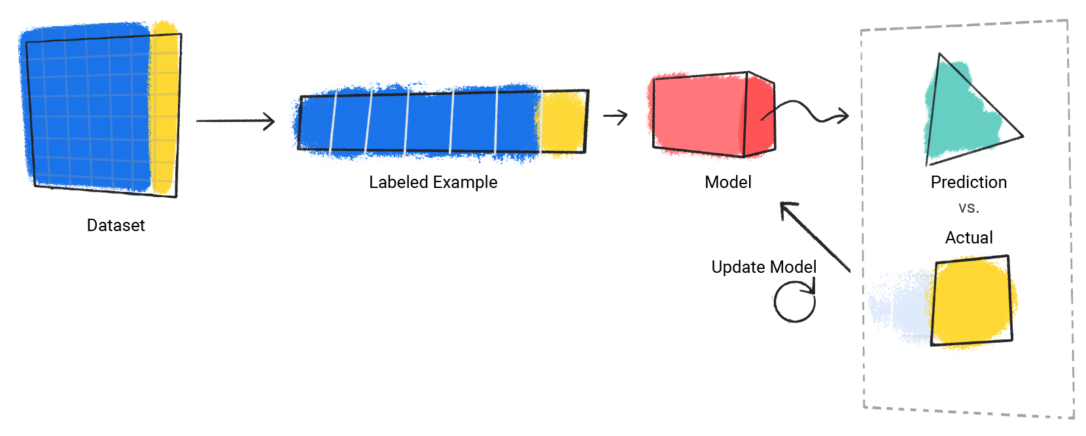
Model Training
This gradual understanding is also why large and diverse datasets produce a better model.
It will allow the model to see more data with a wider range of values and has refined its understanding of the relationship between the features and the label.

Slide 17
Model Training
During training, ML practitioners can make subtle adjustments to the configurations and features the model uses to make predictions.
For example, certain features have more predictive power than others. Therefore, ML practitioners can select which features the model uses during training

Slide 18
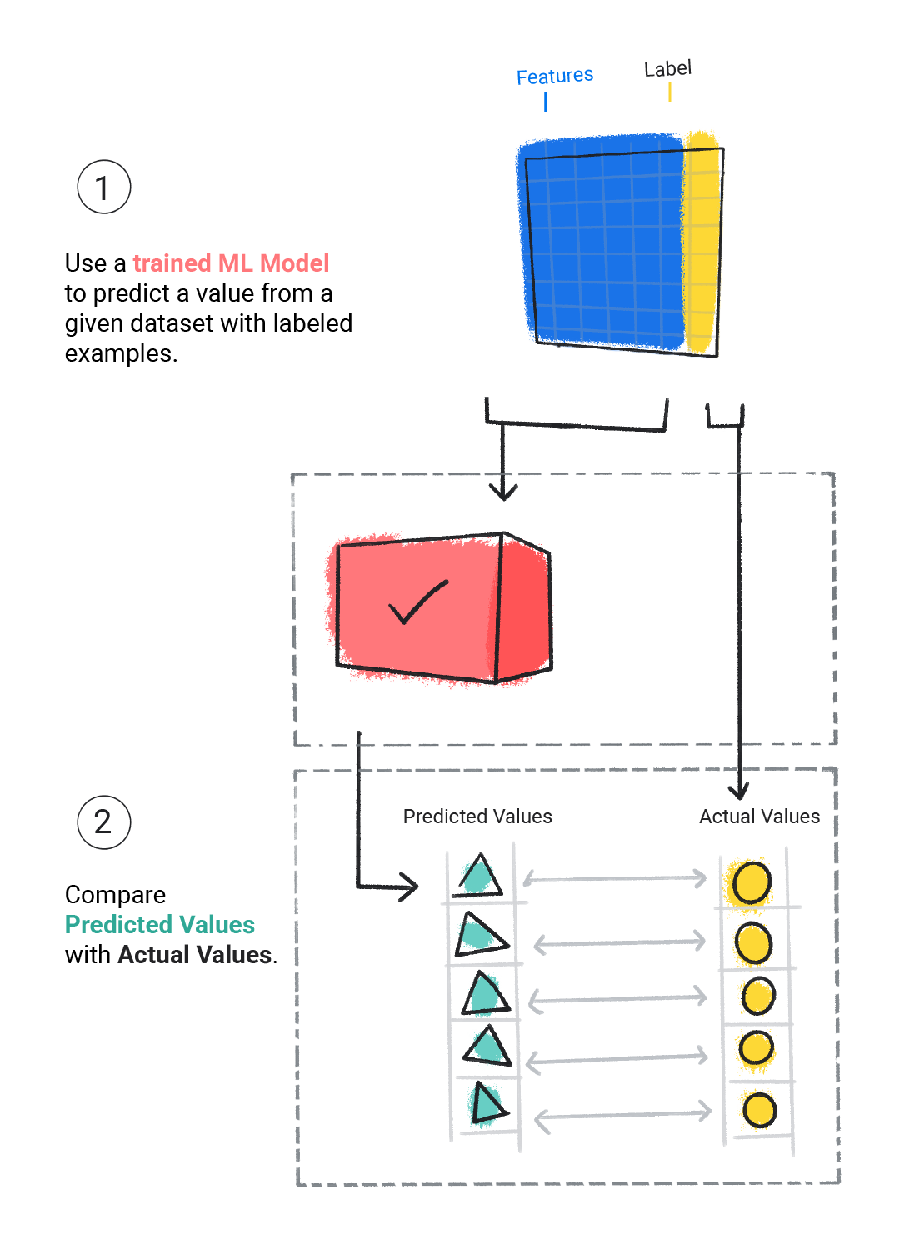
Model Evaluation
We evaluate a trained model to determine how well it learned.
When we evaluate a model, we use a labeled dataset, but we only give the model the dataset's features.
We then compare the model's predictions to the label's true values.

Slide 19

Model Inference
Once we're satisfied with the results from evaluating the model, we can use the model to make predictions, called inferences, on unlabeled examples.
For example, we would give the model the current weather conditions like temperature, atmospheric pressure, and relative humidity and it would predict the amount of rainfall.

Slide 20
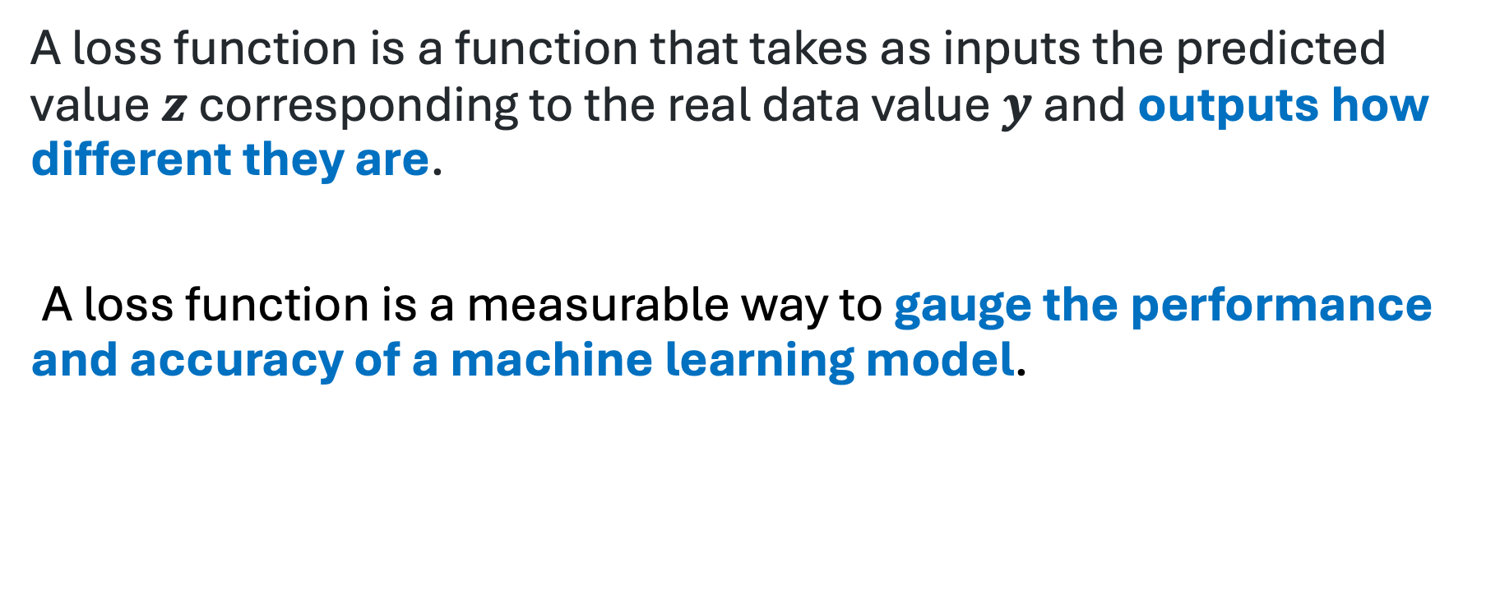
Loss Function
A loss function is a function that takes as inputs the predicted value $z$ corresponding to the real data value $y$ and outputs how different they are.
A loss function is a measurable way to gauge the performance and accuracy of a machine learning model.

Slide 21
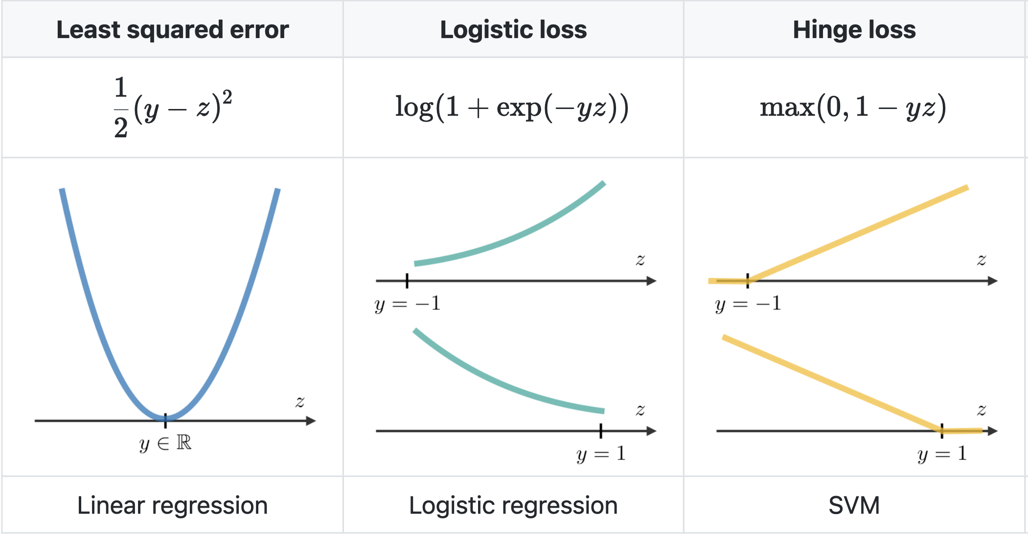
Loss Function

Slide 22
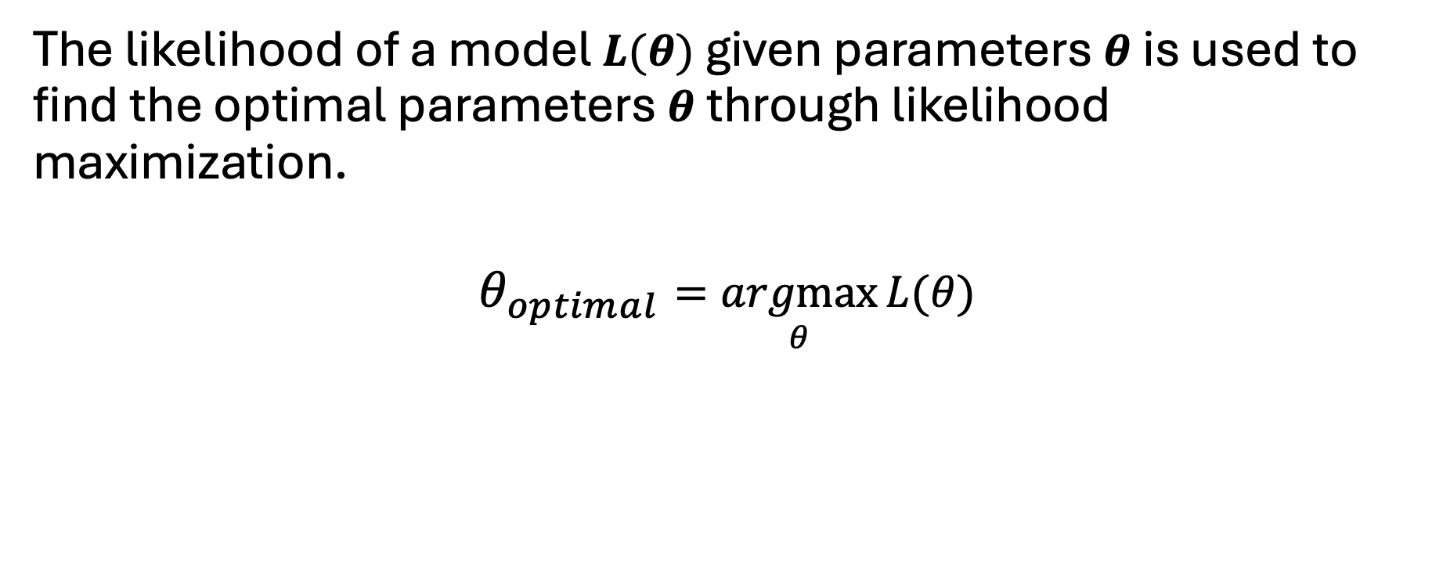
Likelihood
The likelihood of a model $L(θ)$ given parameters $θ$ is used to find the optimal parameters $θ$ through likelihood maximization.
$$θ_{optimal}=\underset{θ}{argmax}{L(θ)}​$$

Slide 23
References
https://developers.google.com/machine-learning/intro-to-ml/what-is-ml
https://stanford.edu/~shervine/teaching/cs-229/cheatsheet-supervised-learning

